Slide 1
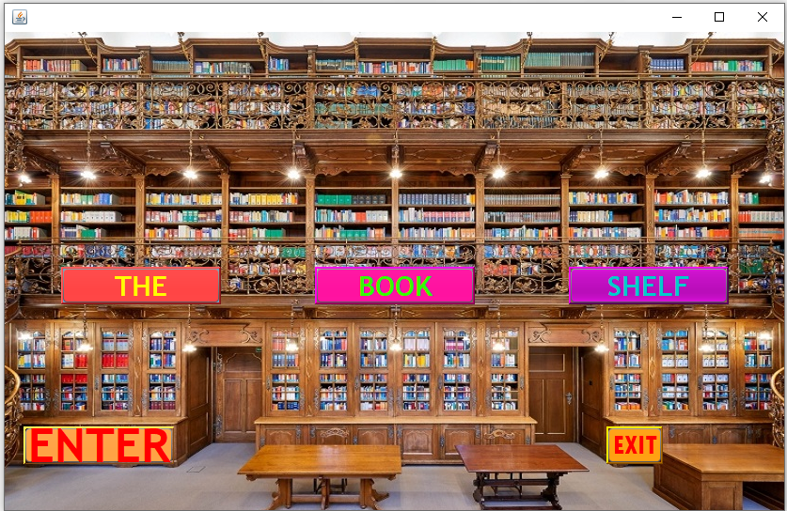

Slide 2
Objective :
1.The main objective of library management system is to handle the entire activity of a library.
2.The system keeps track of all the information about the books with their details.
3.The system contains database where all the data or information will be sorted safely.

Slide 3
Features:
1.Add a log in page where student can log through their id.
2.Add, modify and delete book details into the database.
3.Add students records upon issue of a book.
4.Record issue date, return date, and fine (penalty).
Language :
Java Platform : Netbeans IDE : 8.2

Slide 4
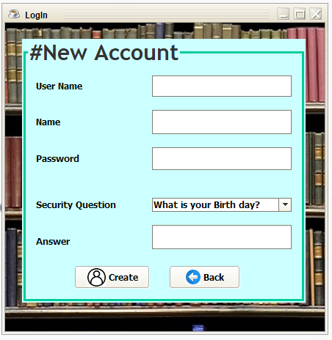
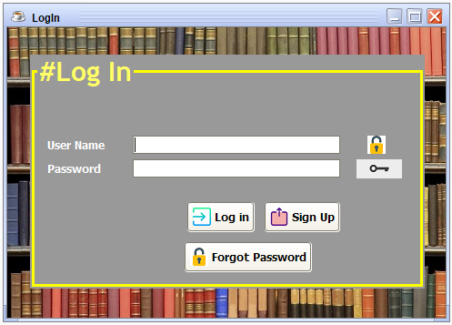
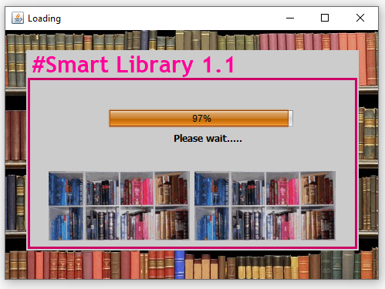
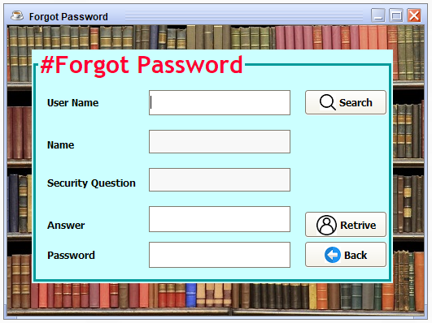
The Login Page

Slide 5
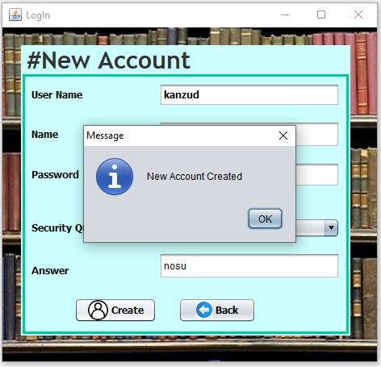
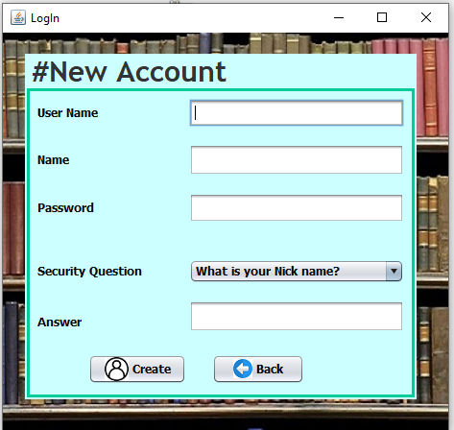
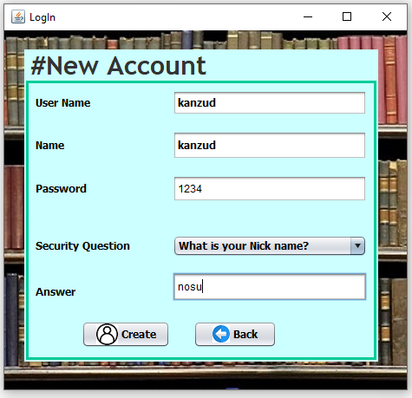
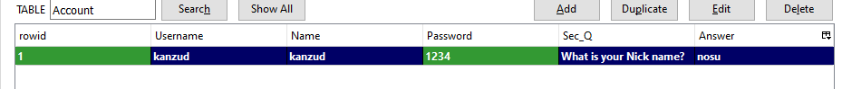
Signup Frame:
1.Fill up the form
2.Click the Create
Database Look:

Slide 6
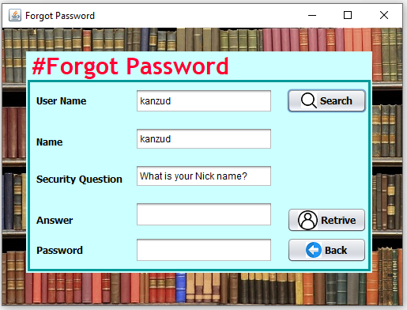
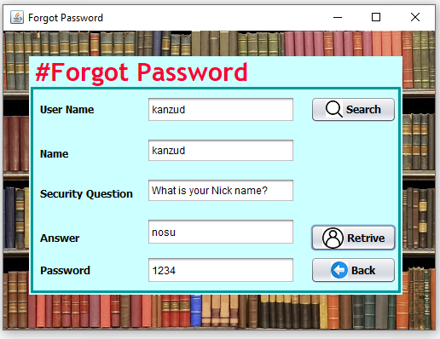
Forgot Password:
1.First click the search button
After finding the correct name.
2.Click the retrive button.

Slide 7
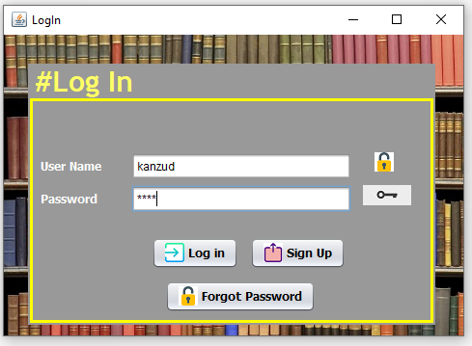
Login page, Progressbar and Jtattoo:
After Clicking Login Button

Slide 8
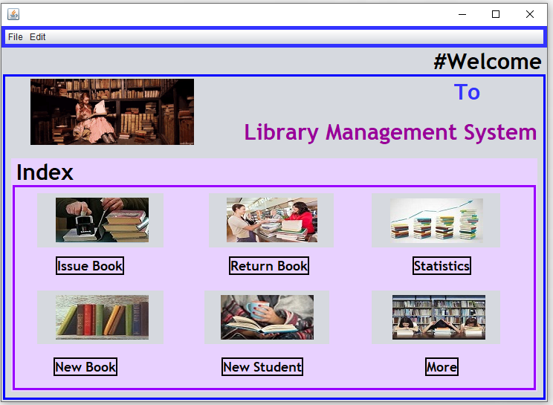
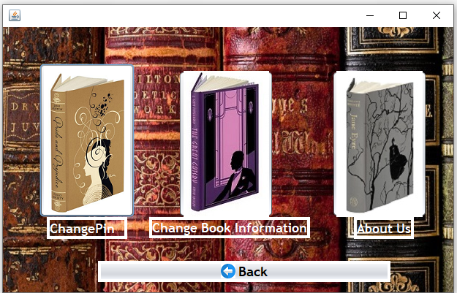
Index Pages:
1.Issue Book
2.Return Book
3.Statistics
4.New Book
5.New Student
6.More
7.Change Pin
8.Change Book Information
9.About Us

Slide 9
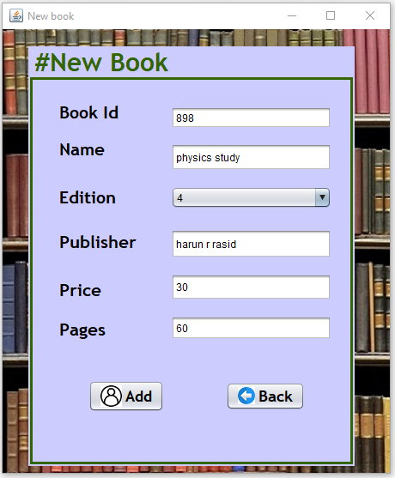
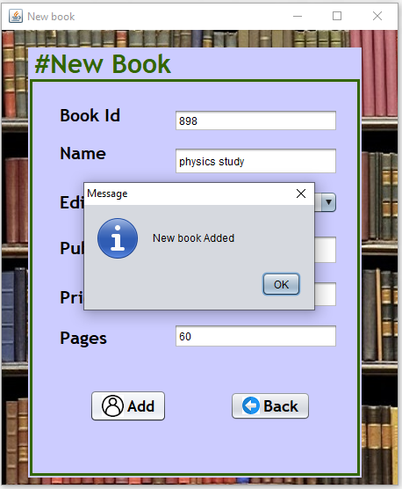
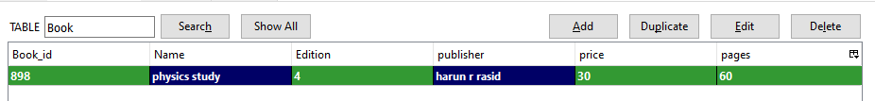
Add New Book:
After clicking add:
Database Look:

Slide 10
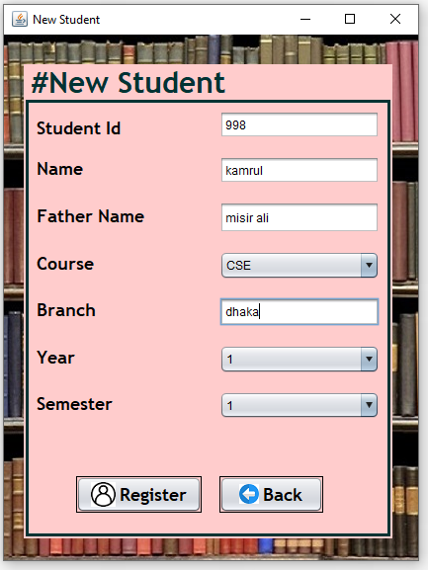
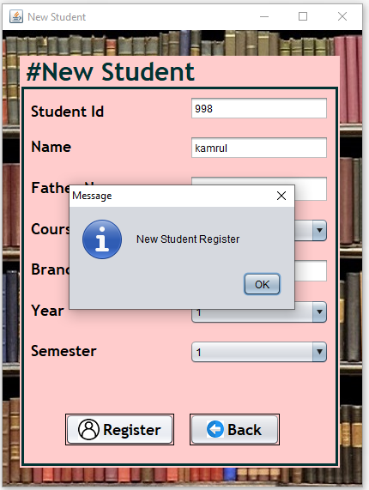
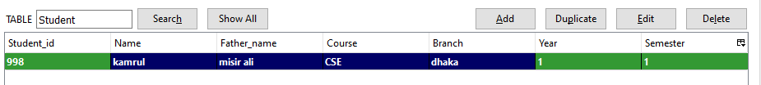
Add New Student
Database Look:

Slide 11
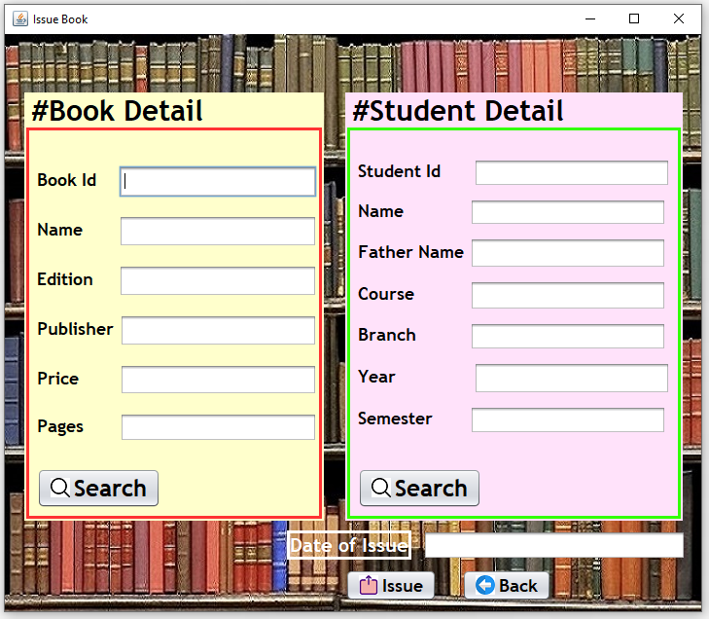

Issue Book(part 1):
1.Write the book id
2.Click search button
3.The other information
will be shown automatically

Slide 12

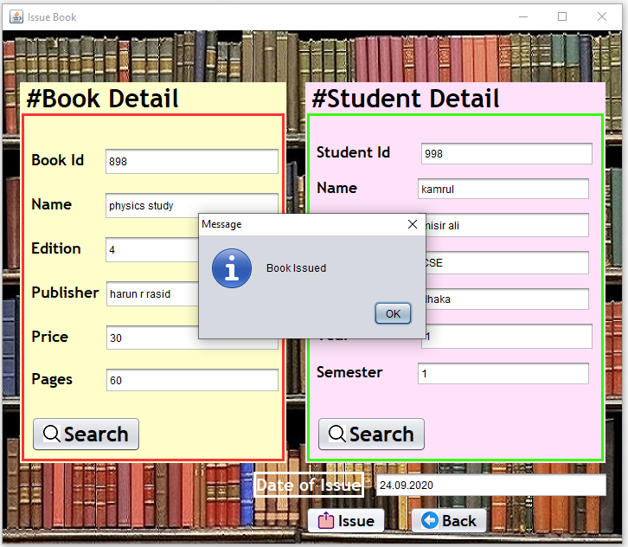
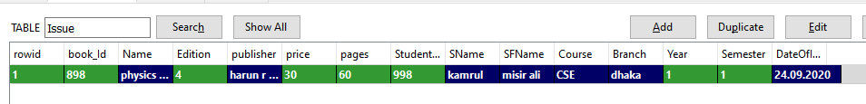
Issue Book(part 2):
1.Write the student id
2.Click search button
3.The other information
will be shown automatically
4.Then need to write issue date
5.Then click issue button
Database Look:

Slide 13
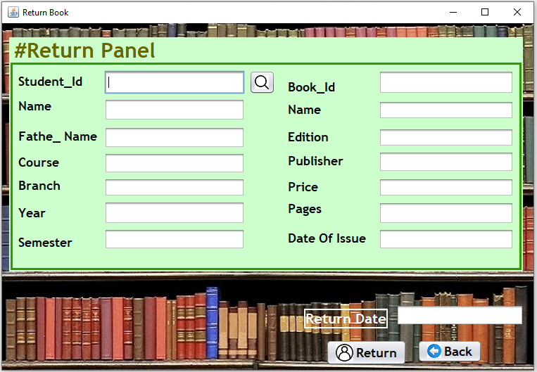
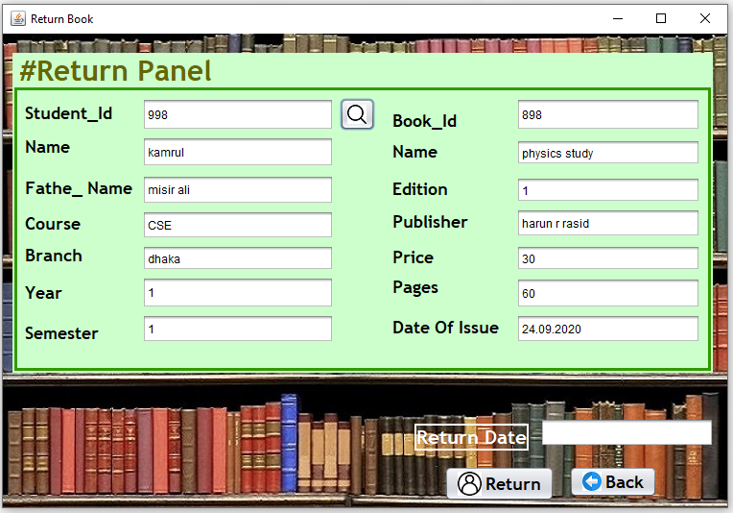
Return Book(part1):
1.Write the student id
2.Click search button
3.The other information
will be shown automatically

Slide 14
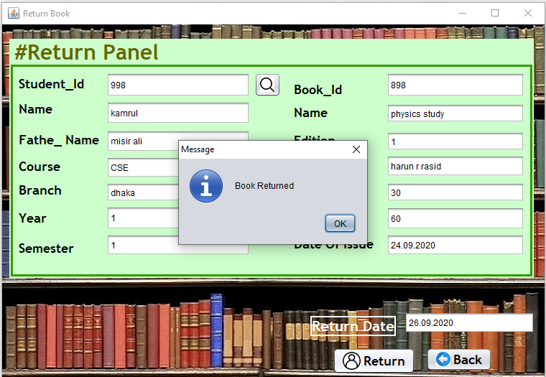
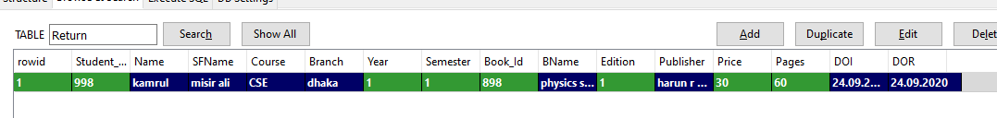
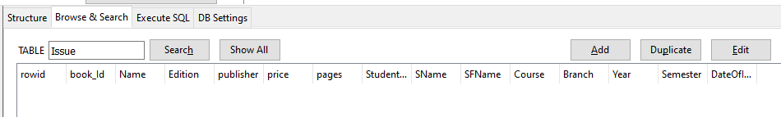
Return Book(part2):
4.Then need to write return date
5.Then click return button
Database Look:
Return Database:
After returning book the issue data must be deleted from issue database
Issue Database:

Slide 15
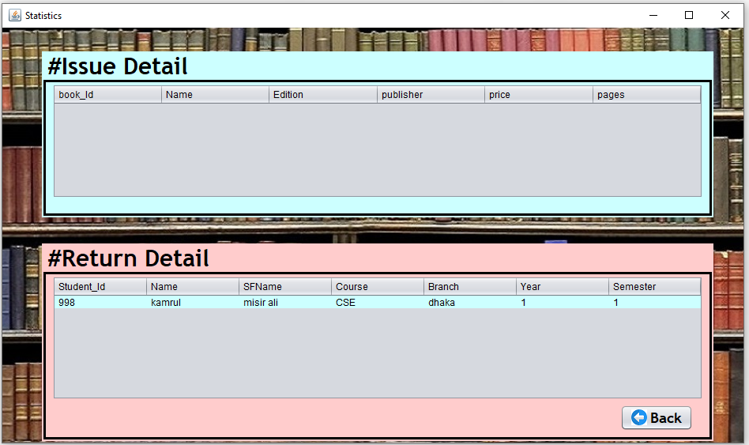
Statistics Bar:
We can see issue and return details here

Slide 16
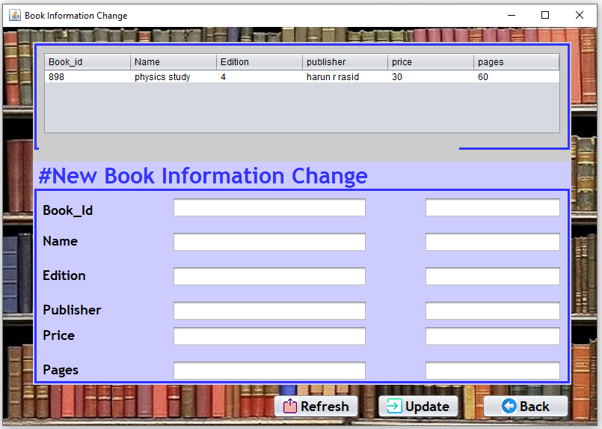
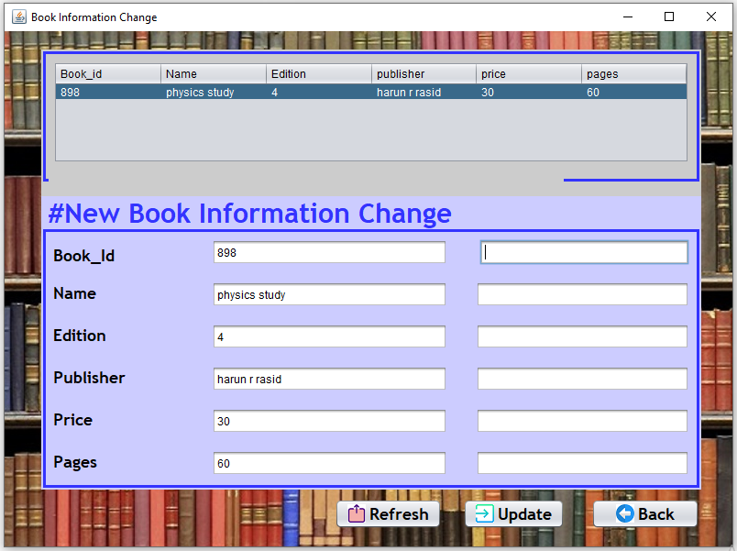
Change Book Information(part1):
By clicking table we can find all the information here:

Slide 17
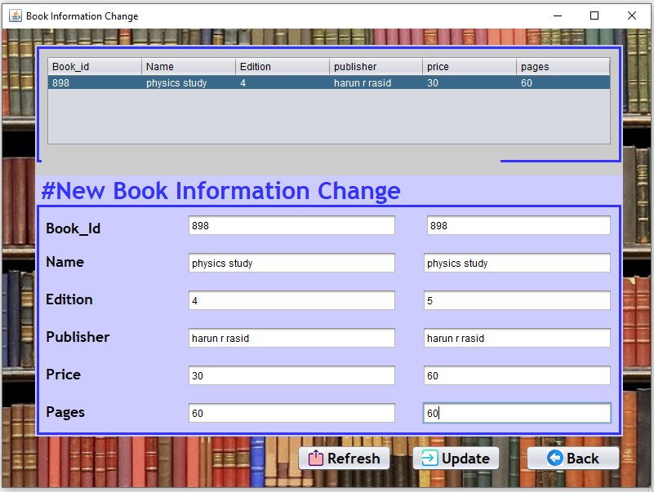
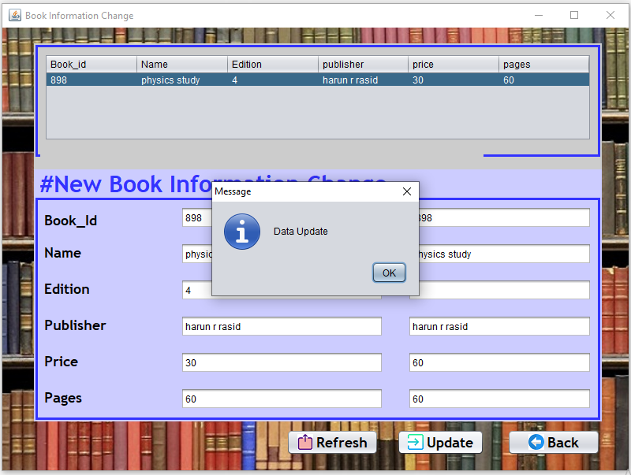
Change Book Information(part2):
Old Database
New Database:

Slide 18
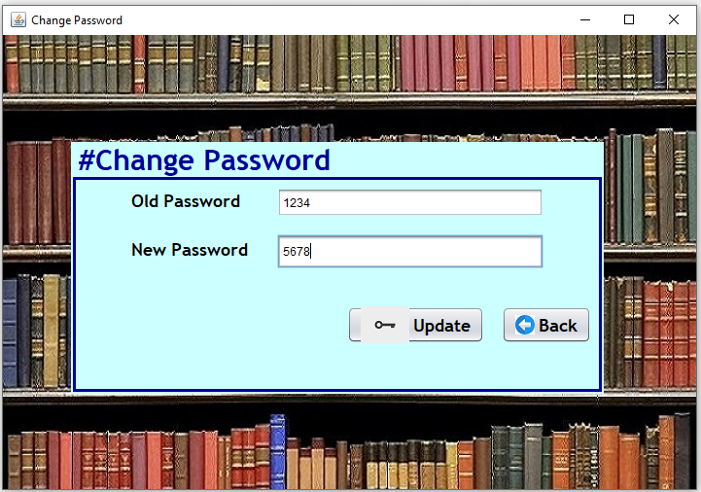
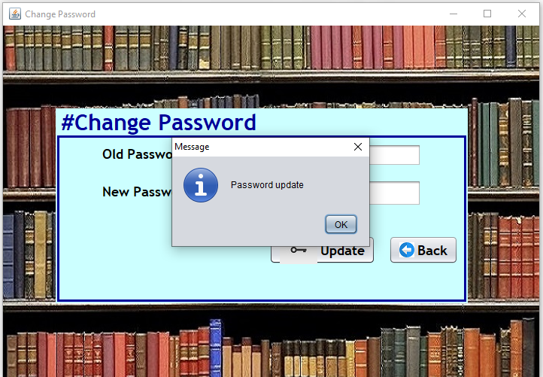
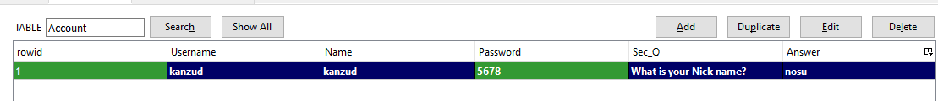
Change Password:

Slide 19
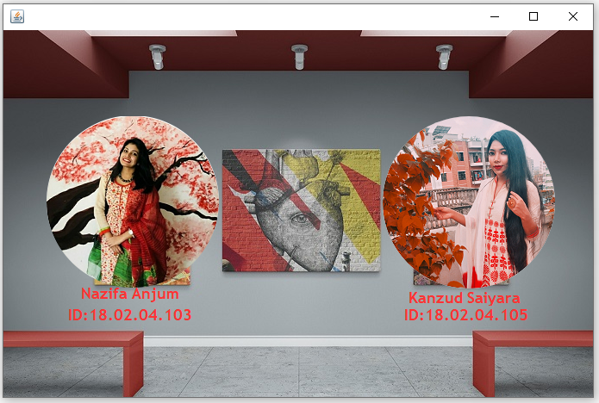
About page

Slide 20
Thank you
Any Question ?

